Slide 1
Lifecycle of Hydrocarbons trapped in Soil –An Explorable Explanation
Janani Kumar
Atharva Naik

Slide 2
Why this Problem?
We know that Crude Oil is a non renewable resource of energy.
We know that Oil extraction requires Off-shore drilling.
We know that Off-shore drilling can be dangerous.
We know that when these non-renewable energy sources are used pollutants are released.
We seem to know a lot of facts, but how interconnected are these facts in our head?
Our goal is to create a simple explorable explanation that highlights the integration of systems in play with respect to oil drilling for someone who is learning about it for the first time.

Slide 3
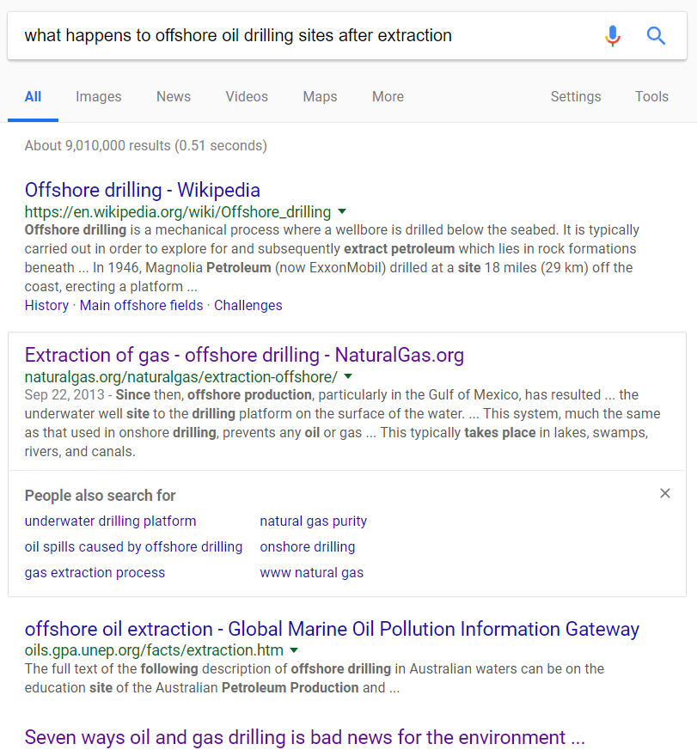
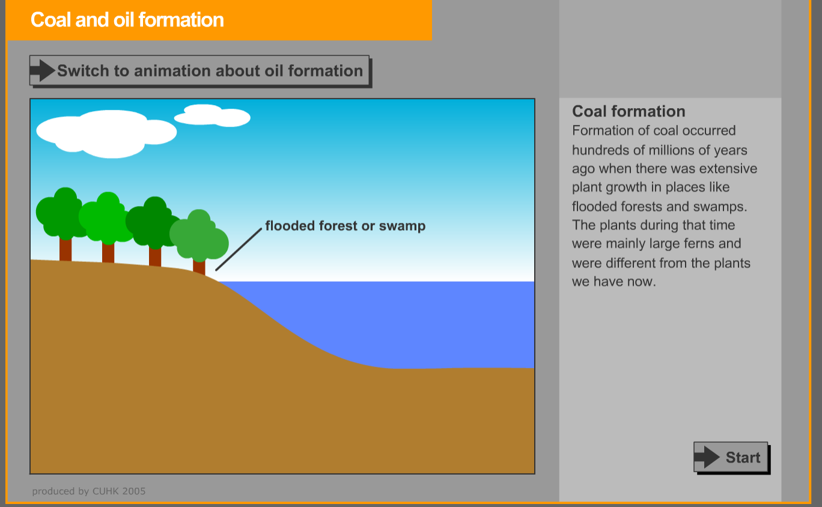
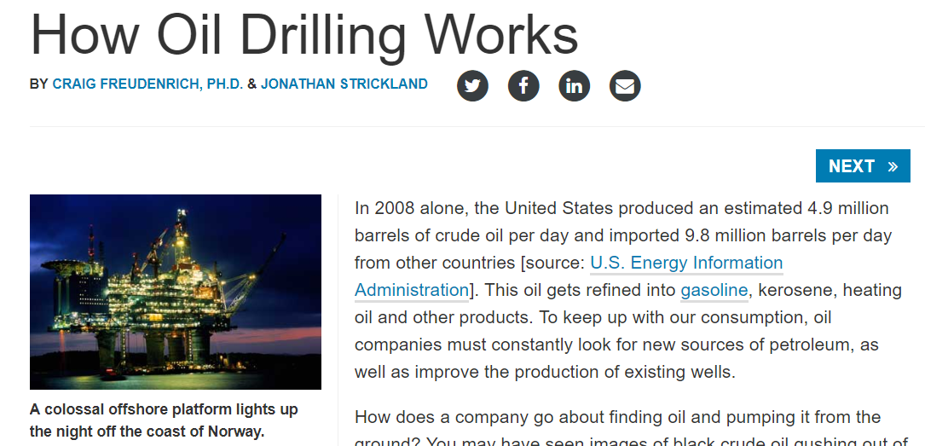
Related work

Slide 4



Our Process – Nicky Case Process
Start with a question
Answer the question
Allow exploration.
End with more questions
Images from: https://blog.ncase.me/how-i-make-an-explorable-explanation/

Slide 5
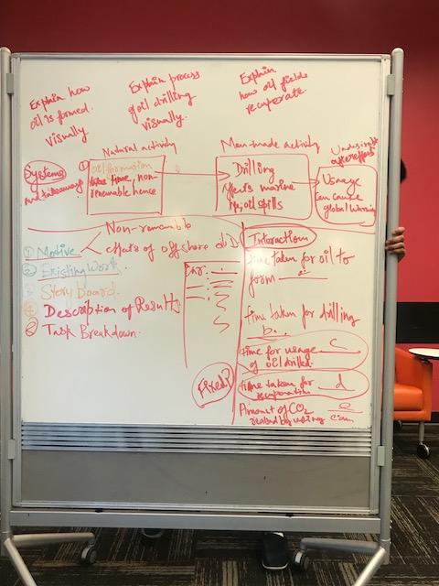
Task :Introduce system level thinking of the ideas that have to be conveyed.
How?: Using Loopy
Task: Explain key processes visually.
How? Stop motion animation
Task: Leave the reader with more questions and resources.
How? Interactive data exchange.
Goal: Create a webpage encompassing the output of each task.

Slide 6
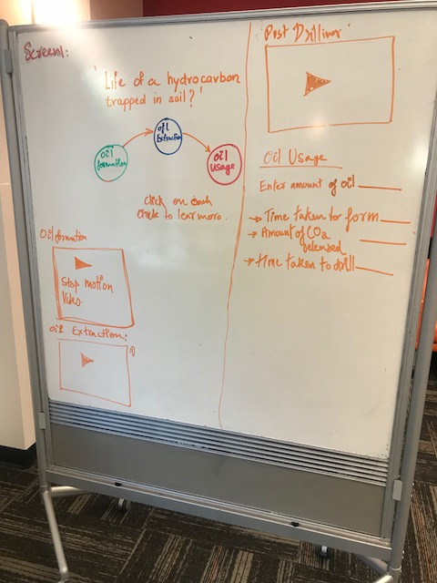
Story Boarding
Single page consisting of:
Integrated System introduction
Animate steps
Interactive data exchange

Slide 7
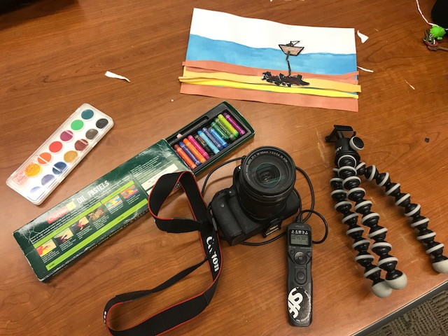
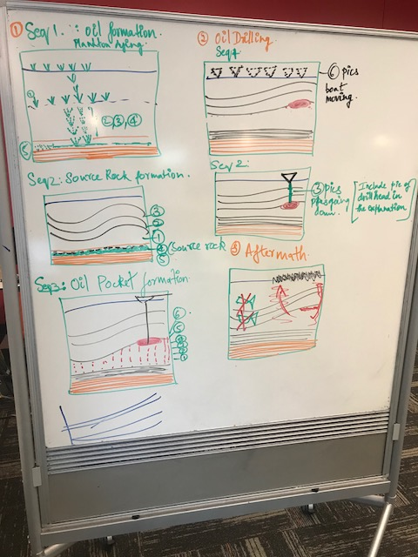
Story Board for stop motion animation

Slide 8
Work in Progress
Demo : http://localhost:8000/Final_project.html#

Slide 9
Next steps and task breakdown
1. Incorporate feedback from today.
2. Annotate stop motion videos.
3.Validate data for collection.
4. Enhance system integration diagram.
5. Learn More section.
Task breakdown:
Conceptualizing, Story Boards, Video capture : Janani and Atharva.
Video Editing: Atharva
Website: Janani

